Slide 1
The Rise of Supply Chain Attacks Updated 25 October 2021

Slide 2
TROSCA > Agenda
Vectors
Self-defense
Big Picture
Q/A

Slide 3
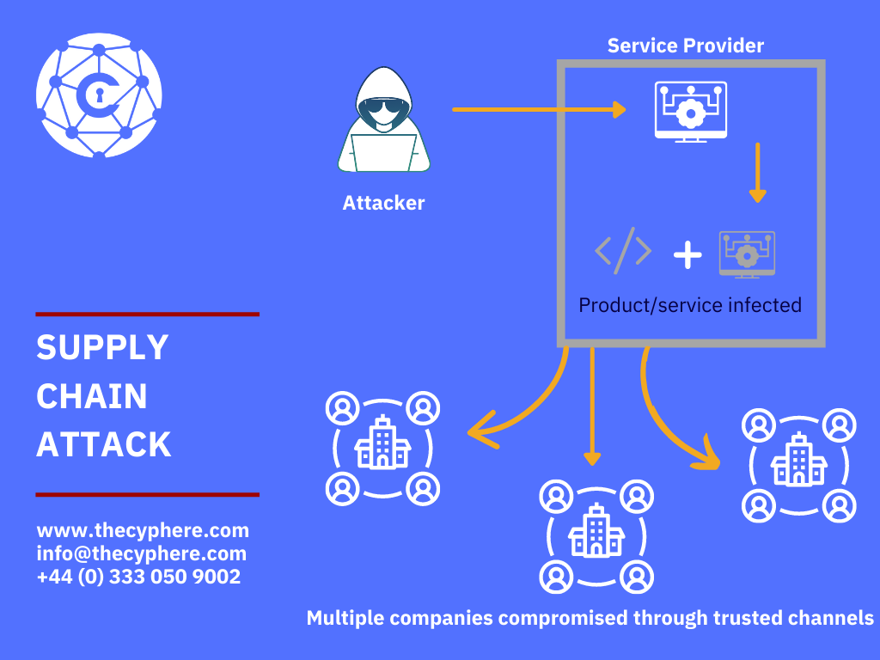
TROSCA > Big Picture > What is a supply chain attack?
A "supply chain attack" is a technique in which an adversary slips malicious code into a trusted piece of software or hardware
By compromising a single supplier, spies or saboteurs can hijack entire distribution networks
Supply chain attacks were first demonstrated around four decades ago when Ken Thompson hide a backdoor in Unix's login function

Slide 4
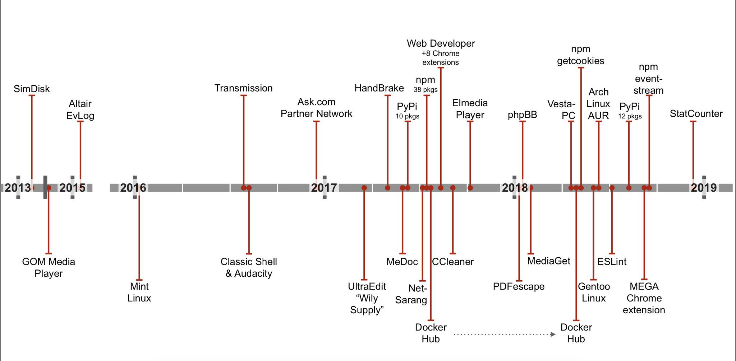
TROSCA > Big Picture > Brief history of supply chain attacks

Slide 5
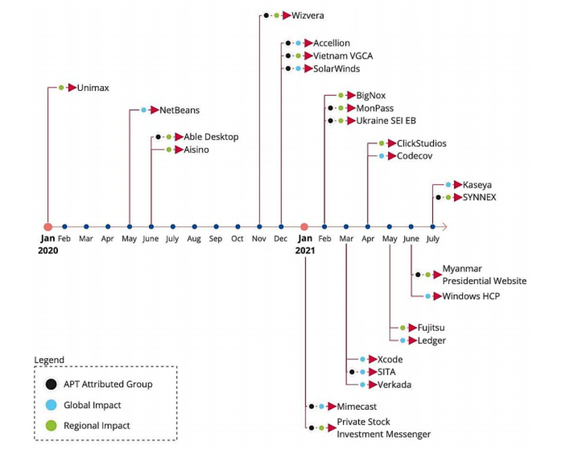
TROSCA > Big Picture > 2020/2021 was a record breaking season
66% of supply chain attacks were committed by exploiting an unknown vulnerability, while 16% leveraged known software flaws
Supply chain attacks most commonly targeted customer data (58%), followed by key people (16%) and financial resources (8%)
Most attacks during the specified timeline aimed to compromise code (66%), followed by data (20%) and processes (12%)

Slide 6
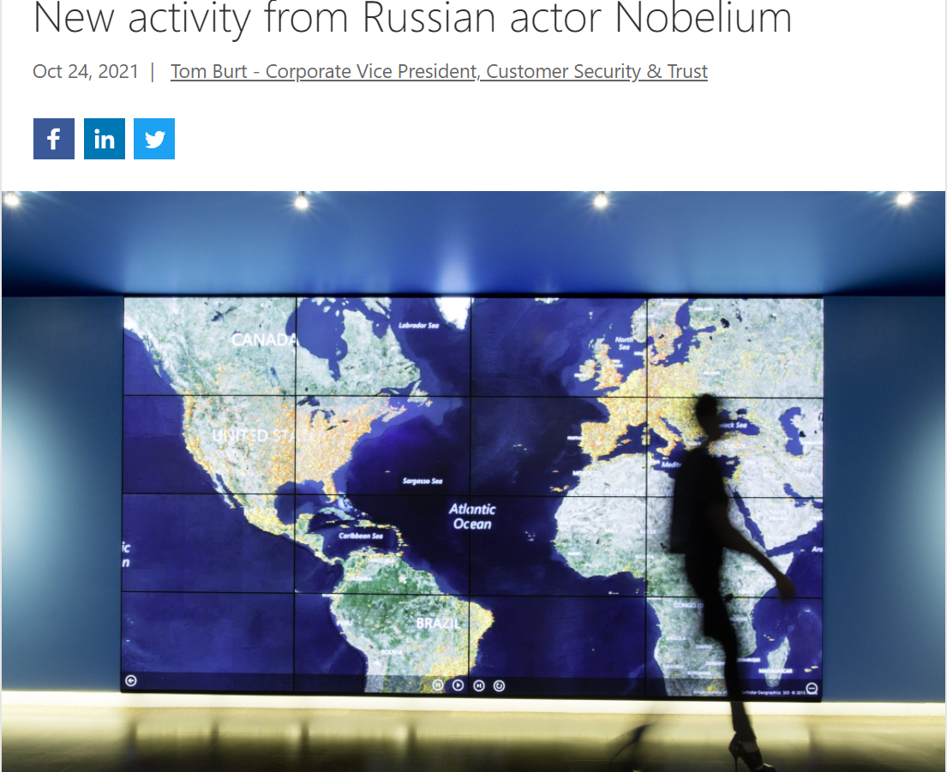
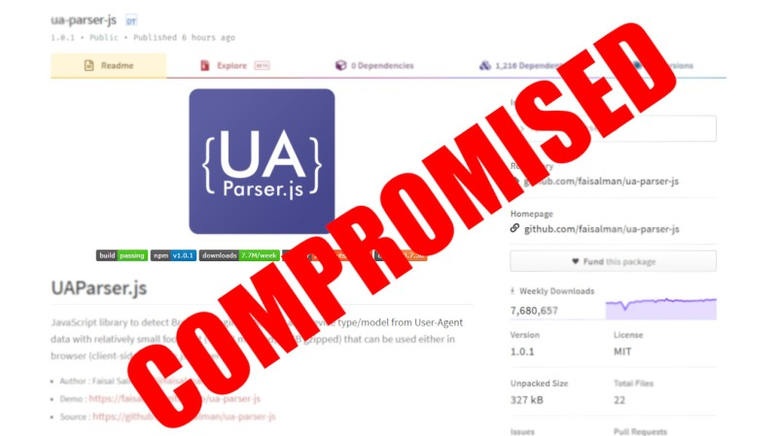
TROSCA > Big Picture > And just recently…

Slide 7

TROSCA > Big Picture > Turtles all the way down

Slide 8
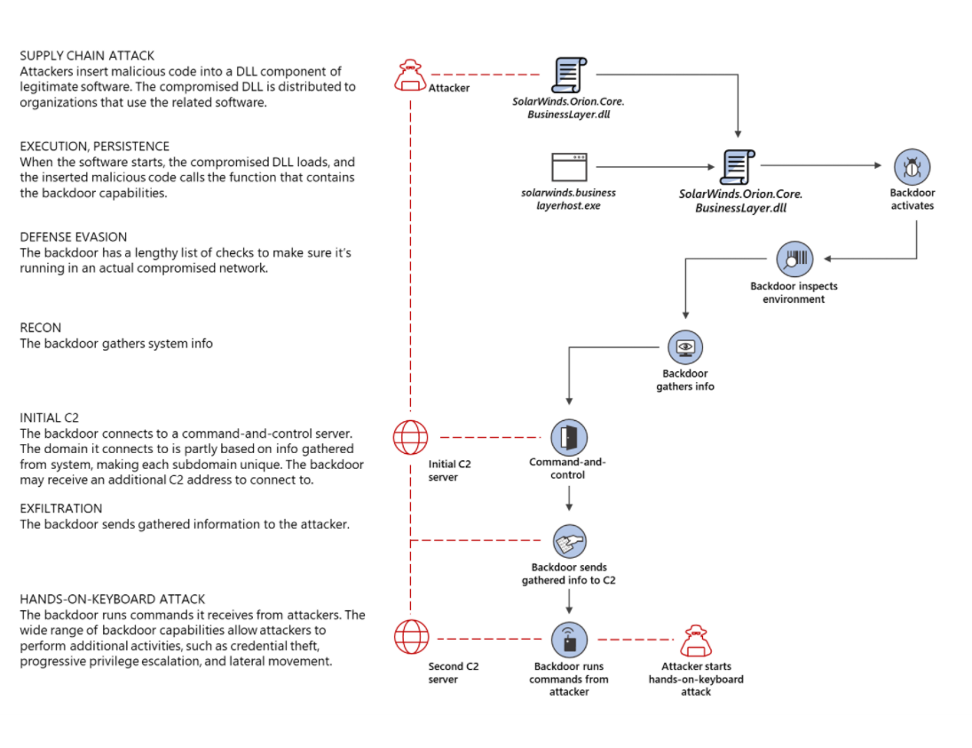
TROSCA > Big Picture > Disecting Solarwinds

Slide 9
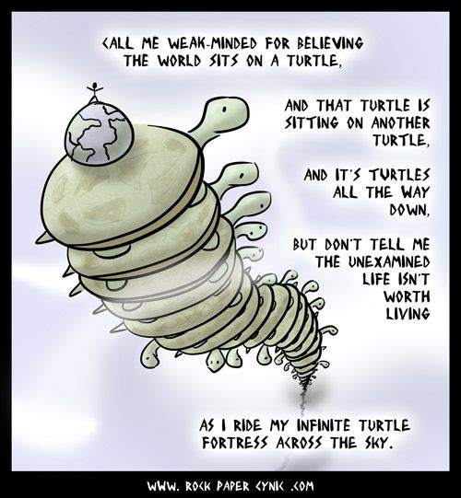
TROSCA > Vectors
Third-party software
Website builders
Third-party data stores
Watering hole

Slide 10
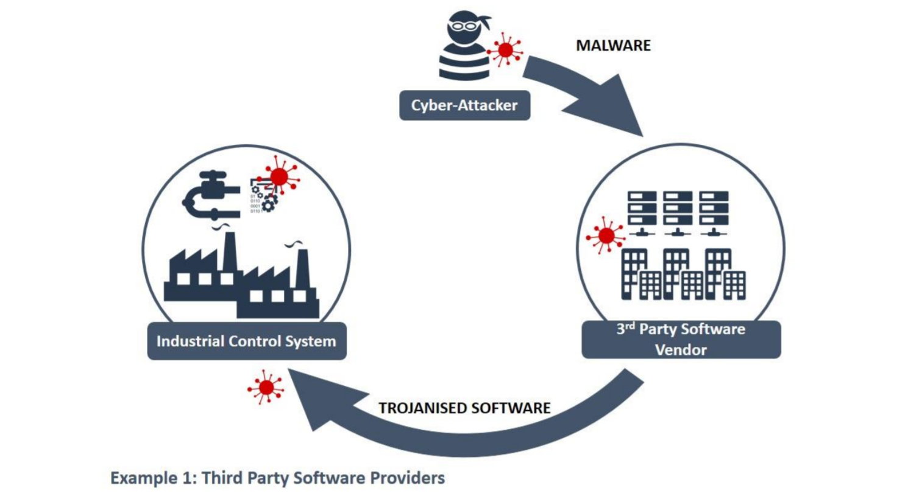
TROSCA > Vectors > Third-party software
Unsuspecting victim downloads infected third-party ICS software
Attacker deployes malware in victims software supply chain

Slide 11
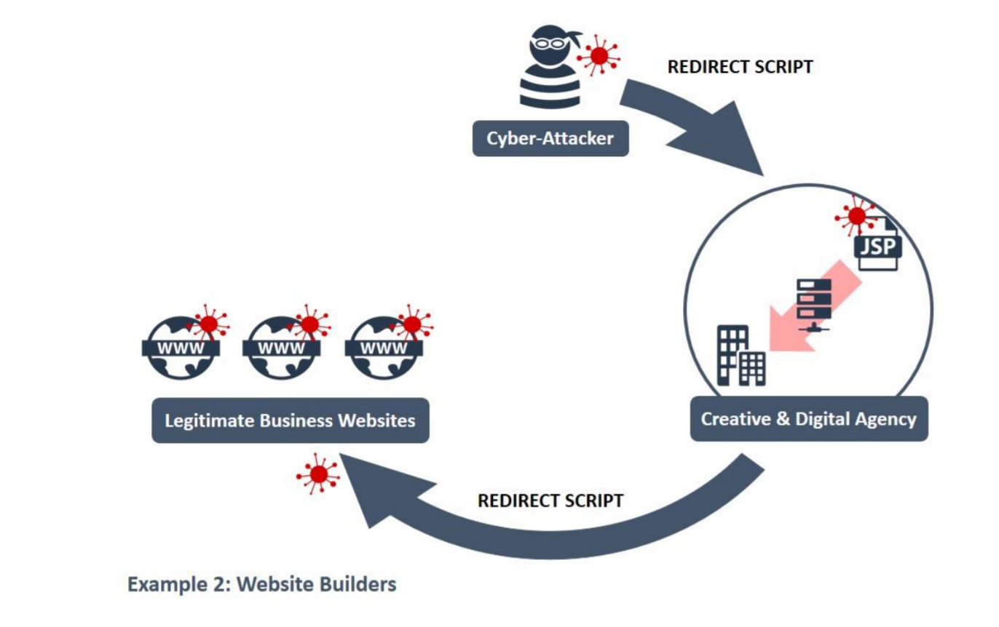
TROSCA > Vectors > Website builders
Attackers compromise legitimate websites through website builders used by creative and digital agencies
Redirect script siphons victims from legitimate sites to a malicious domain owned by the malware authors.

Slide 12
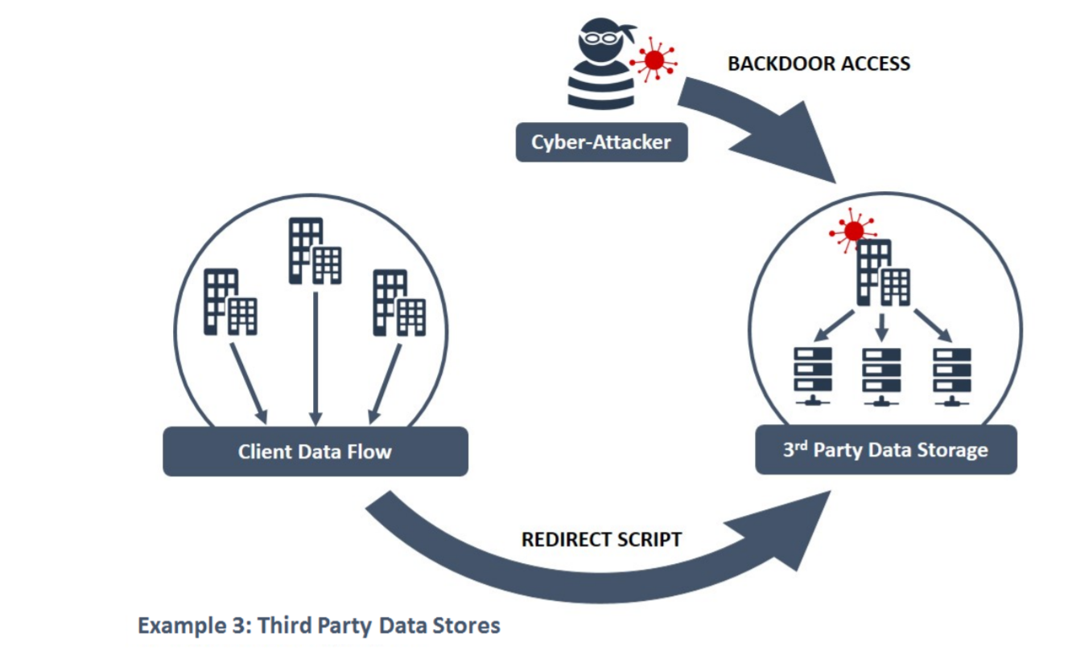
TROSCA > Vectors > Third-party data stores
Victim push data to infected third-party storáge
Attackers compromise third-party data storage used by victim

Slide 13
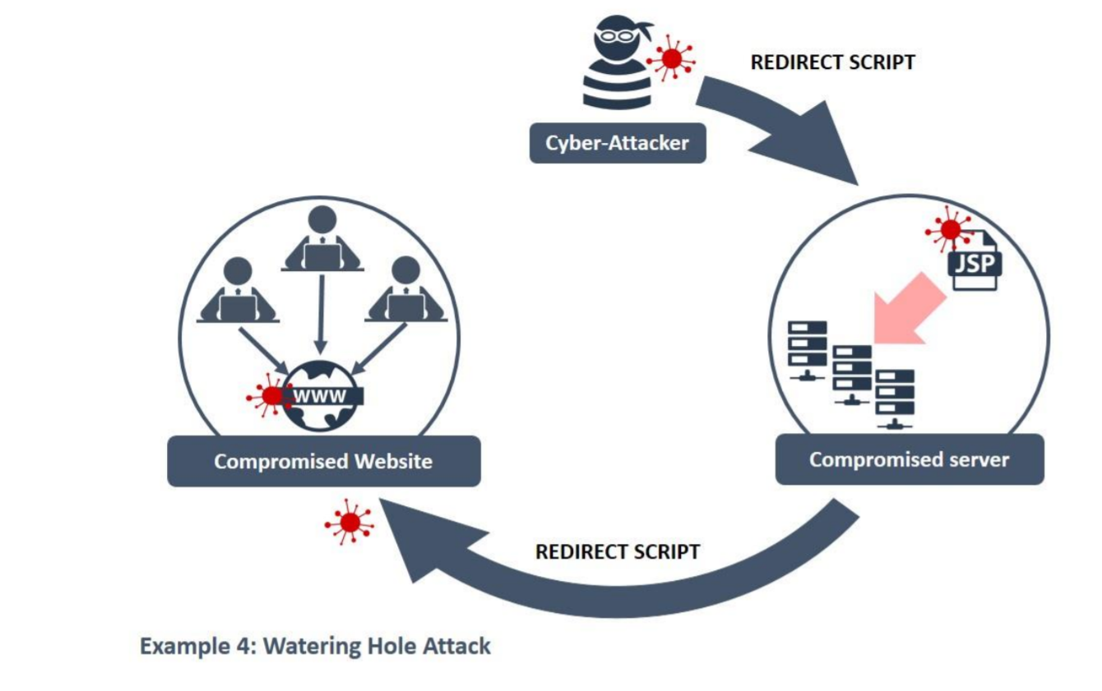
TROSCA > Vectors > Watering hole
Victims unintentionally download Remote Access Trojan malware enabling the attacker to gain remote access
Attackers compromise websites frequented by victim

Slide 14

TROSCA > Self-defense
Understand the risks
Establish control
Check your arrangements
Continuous Improvement

Slide 15

TROSCA > Self-defense > Understand the risks
Understand your supply chain, what needs to be protected and why
Know who your suppliers are and build an understanding of their security strategies
Understand the security risk posed by your supply chain

Slide 16
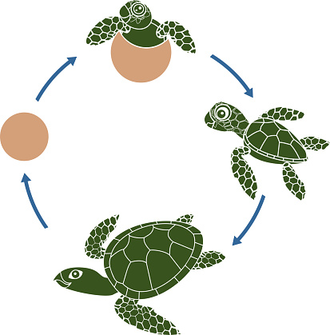
TROSCA > Self-defense > Establish control
Communicate your view of security needs to your suppliers
Set and communicate minimum security requirements for your suppliers
Build security considerations into your contracting processes and require that your suppliers do the same
Meet your own security responsibilities as a supplier and consumer

Slide 17

TROSCA > Self-defense > Check your arrangements
Build assurance activities into your approach to managing your supply chain
Monitor your supply chain for suspicious activities
Help suppliers meet their security obligations

Slide 18

TROSCA > Self-defense > Continuous improvement
Encourage the continuous improvement of security within your supply chain
Build trust with suppliers
Actively test for vulnerabilities

Slide 19
TROSCA > Literature
The evolution of the software supply chain attack
The Enemy Within: Modern Supply Chain Attacks
https://www.wired.com/story/hacker-lexicon-what-is-a-supply-chain-attack/
https://portswigger.net/daily-swig/four-fold-increase-in-software-supply-chain-attacks-predicted-in-2021-report
https://thecyphere.com/blog/supply-chain-attack/
https://www.ncsc.gov.uk/collection/supply-chain-security/supply-chain-attack-examples

Slide 20

TROSCA > Q&A

